Slide 1
Using the client role map tool
This role map is a tool to help staff:
Remind staff and other roles what things are helpful/ not helpful to do with client
It is also used to help the client:
With skills including: See face/state name; hear name/ select face;
Provide discrimination training examples and practices for skills like:
Recognizing important people on their team
Stating person’s role when they see their face or hear their name
Stating what the person does and does not do
Stating what the person might say (and should not do)
Prerequisite materials or skills may be helpful:
Some clients and client teams may benefit when we list roles before we meet with the client, to get staff on same page first
If there are specific boundaries that have been violated, teach the appropriate boundary using several examples and non-examples
It might be helpful to practice “noticing” skills (ACT related skills to get calm, take deep breaths, notice surroundings) before using the tool
Notes for using the tool
Before using, remind client (and caregivers!) it’s ok to take a break or stop practicing the tool when needed
We can practice the tool when things are calm
It can be posted as a visual and referred to when calm
Do all the above BEFORE supporting using the tool

Slide 2
My support map
Things we could say
I love you
We will always be family
Long time friends
Not family, but friends
Maybe not forever… but for a long time!
My permanent family
Always in my life even though I may not see them for a while
It’s ok to be angry sometimes. We can make up
I may have more family someday
Things we say
“You are special to me!”
ME
Things they say
“I care about you!”
“I want to help.”
Temporary Professionals in my life
Not forever, but they are helpful right now
Not “friends” because they are doing a job, but special in a different way. They are usually friendly and helpful
Things they say
I do a special job to help you.
I will have to move on when you graduate from my client list someday.
Example

Slide 3
My support map
Things we could say
Example 1
Example 2
Role:
Clarifying statement about what this role IS
Clarifying statement about what this role is not
Example of person’s name in this role
Role:
Clarifying statement about what this role IS
Clarifying statement about what this role is not
Example of person’s name in this role
Things we say
Example 1
Example 2
ME (my name and pic)
Things they say
Example 1
Example 2
Role:
Clarifying statement about what this role IS
Clarifying statement about what this role is not
Example of person’s name in this role
Things they say
Example 1
Example 2
Sample template

Slide 4
Example of supporting client*, using the role map tool
* Note that this example is for a particular client, for whom these statements are developmentally appropriate and have been prefaced by skills assessment, acquisition and practice.
Client says “will you be my friend forever? “
“That’s such a great question! Thank you for asking! I am Cindy. This is my picture and name on your map. What do I usually say about friends?”
“a friend is someone who chooses to play with me and we do things together when we want to”.
“That’s right! I am someone who is FRIENDLY, but I am different than a friend. I am one of your HELPERS. My helper job is your THERAPIST. Your team pays me to help you! I am not called a friend, but I can help you learn the things that you use in your friendships. I wonder if you have any more questions or if you would like to look at your calendar and see when your friend is coming over next. “
looks at Calendar and says “Tuesday! Adam is coming Tuesday. I want to pretend and practice for Tuesday. Can we play dolls?”
“Absolutely! That’s right, Tuesday your friend Adam is scheduled to come play! Let’s play dolls and practice some things you and Adam can do and say!”
The pictures, words, examples and lesson are adapted for individuals’ needs.

Slide 5
The Teaching Interaction Procedure (TIP)
Useful and well-researched with teaching members of groups
Autism and social skills
Staff training
Trauma backgrounds
“The TIP was developed in the early 1970s as part of the teaching family model for court-adjudicated youth (Phillips 1968)”
Contains discrete steps like DTT, but “delivered in a more natural conversational and interactive manner”
Research suggests is more effective than Social Stories in comparison studies (see Leaf et al. 2012)
Research
Green, D. R., Ferguson, J. L., Cihon, J. H., Torres, N., Leaf, R., McEachin, J., et al. (2019). The teaching interaction procedure as a staff training tool. Behavior Analysis in Practice. https://doi.org/10.1007/s40617-019-00357-2.
Peters, B., Tullis, C. A., & Gallagher, P. A. (2016). Effects of a group teaching interaction procedure on the social skills of students with autism spectrum disorders. Education and Training in Autism and Developmental Disabilities, 51(4), 421–433.
Phillips, E. L. (1968). Achievement place: Token reinforcement procedures in a home-style rehabilitation setting for “pre-delinquent” boys. Journal of Applied Behavior Analysis, 1(3), 213–223.
Taubman M. (2020) Teaching Interaction Procedure. In: Volkmar F. (eds) Encyclopedia of Autism Spectrum Disorders. Springer, New York, NY. https://doi.org/10.1007/978-1-4614-6435-8_102238-2
https://link.springer.com/referenceworkentry/10.1007/978-1-4614-6435-8_102238-2
Basic Steps of the TIP
Task analysis used to break down the steps. There is prompting, feedback, repeated practice, and reinforcement every step of the way/ as needed.
Me/ the teacher | Other person (a staff or student)
Make a statement introducing and labeling the skill | Other person labels the skill
State rationale (why we are working on this) | Other person states the rationale
State rationale, time and place it will be used | State rationale and context
Name the steps | Names the steps
Demonstrates the steps | Demonstrates the steps
Roleplays the skill in context | Roleplays (and switches roles)
https://www.swsc.org/cms/lib04/MN01000693/Centricity/Domain/130/Marissa%20-Teaching%20Protocol%20for%20Teaching%20Interaction%20Procedure.pdf

Slide 6
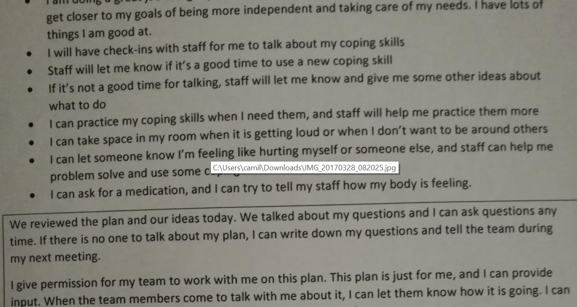
No regular attention without talking to client about it (topic for discussion: trust; safe relationships) See example below for informed consent items we included for a client’s NCR

Slide 7
Mental Health Support:
Paranoid Schizophrenia (hears voices of angels and has delusions, but does not have command hallucinations)
Needs providers who can be consistent, preventative, and supportive
Client-At-A-Glance
Sheri has an easier time when:
People honor her preferences, such as taking her sugar levels before she eats
People provide privacy
People provide choices and “dignified ways out” so she can assert her own choices even in an environment where there are others making decisions
People are respectful, polite and kind with her
Recent History:
Has lived with roommates in the past in Hospital and did fine
Can advocate for her needs appropriately
Last year (2021) in hospital there was skin breakdown treated effectively with time out of room
Sheri
Sheri is:
17 years old; kind and polite with staff who know her
Sheri has:
Insulin-dependent diabetes; been divorced; been deprived of family contact for many years
Sheri thrives when:
She is doing something to keep her mind sharp; people help by giving her choices and autonomy
Sheri values:
Taking care of herself; her privacy; having relationships, friends and family members; art, music and beautiful things
Sheri sometimes struggles with:
Self-care
Taking all of her prescribed medications (she does not struggle with this since gaining med cert)
Being in an environment where she has little control
Cognitive functioning:
Often enjoys learning new things
Example: Requested art therapist provide her information about art history
Likes keeping herself sharp by writing, doing math facts, multiplication, etc
Behavioral Health Needs
When off medications or in a diabetic crisis, she may go through challenges with minor aggressive behavior or calling names
May show paranoia and agitation when refusing medications
Generally takes her court ordered medications
It is supportive to give her choices and options so that she can have control by refusing something that is not life threatening, and maintain autonomy
Physical needs:
Has Type 2 diabetes
Hypertension and hyperlipidemia
Obesity due to excess calories
Ambulatory but sometimes enjoys using a walker or wheelchair
Medical refusals: See back grey boxes; Follow preventative procedures to give options and choices and a second chance. If refuses court ordered meds follow “unsafe refusal protocol”, Contact (NAME) at (EMAIL), PHONE, CRISIS # as backup: _____

Slide 8
PREVENTIVE TECHNIQUES
Be polite and respectful”: offer the best option but honor her appropriate requests.
Approach thoughtfully: Be positive and friendly and smile.
Use momentum: Give a compliment or use friendly small talk right before a request
Give options: Use an approach that avoids open ended questions but embeds 2 alternatives
Come back and try again a little while later if she politely refused earlier today but you still need to get something done
Meals (Client is diabetic but used to selecting food from a diabetic friendly menu)
“Almost time to eat. Let me know if you want to sit in the dining room or computer room!”
“Today we are having meatloaf, mashed potatoes and rolls. Does that sound good or would you rather check out this grill menu”
“Here’s your food. Let me know if there’s anything else you need”
Meds and Medical Procedures
“Time for lunch! (while showing her the needle) Let’s get your blood sugar; show me which finger you want to use today.”
“Ooh, I love these flowers! Your room smells so nice. Time for meds, you can take _ or ___ first.”
I hear you that you wish you didn’t have to take these meds. This is one the court says is important for your health and safety so you need to take it. You can take it now or I’ll come back in 10 minutes.
Behavior notes
Honor refusals that are appropriate and safe (Examples: “I don’t want to take these today”; “I don’t want to talk about ___”; “I’m not hungry right now”; “No thank you” (the first time a med is offered)
If behavior escalates
1. Record signs of behavioral escalation and/or mental health symptoms: Using derogatory words; Higher voice volume; Refusing meds for more than 1 day; Talking about delusions/ hallucinations more often
2. Contact Mental Health provider and notify them
3. Continue to use preventative language, honoring any APPROPRIATE refusals/requests
4. Start unsafe refusal protocol
Showering/ Hygiene
“Time to get clean and dressed up for the piano group! I can help do your hair after we get the shower done. Let’s take a walk together and figure out which one you want to use today”
(If “I don’t want to shower”: “Thanks for letting me know. We can clean you up in your room. Does it sound best before breakfast or before lunch?” (before lunch) “ok, I’ll see you around 11!”)
UNSAFE REFUSAL PROTOCOL (An unsafe refusal means she is refusing something and being unsafe (using unsafe behavior to staff including hurting someone, threatening or breaking things) OR refusing something that is medically necessary (refusing to take court ordered meds)
Follow all preventative procedures and if possible, re-approach later with respect and options
Contact _________ and let (name) know what is happening: (email: ____ and phone: ______)
Call to inform _____(hospital name) Behavioral health unit
Call crisis unit at _________ and explain problem. If they cannot come out:
Call 911 and provide letter to emergency responders
Keep guardian (name, phone) informed

Slide 9
Mental Health Support:
Client-At-A-Glance
Client has an easier time when:
Recent History:
Client (pic or name)
Client is:
Client has:
Client
thrives when:
Client values:
Client sometimes struggles with:
Cognitive functioning:
Behavioral Health Needs
Physical needs:
Most critical need:
Contact:

Slide 10
PREVENTIVE TECHNIQUES
Behavior needs (name behavior, list prevention or responsive steps)
Meds and Medical Procedures
Behavior needs (name behavior, list prevention or responsive steps)
Behavior needs (name behavior, list prevention or responsive steps)
EMERGENCY PROCEDURES

